Slide 1
GRNs, Boolean networks, networkx, coding

Slide 2
Using Github (from last time)
git clone https://github.com/SES591/Example_Codes.git
You only need to do this once.
To update example codes, run inside the repository:
git pull

Slide 3
Networks in Systems Biology
Gene regulatory network: two genes are connected if the expression of one gene modulates expression of another one by either activation or inhibition
Protein-protein interaction network: proteins that are connected in physical interactions or metabolic and signaling pathways of the cell

Slide 4
Gene Regulatory network
Gene regulatory networks (GRNs) are the on-off switches of a cell operating at the genetic level
In a GRN, two genes are connected if the expression of one gene modulates expression of another one by either activation or inhibition

Slide 5
Modeling GRNs
A gene regulatory network can be represented by a directed graph
Nodes represent a genes
Directed edge stand for the modulation (regulation) of one node by another:
e.g. arrow from gene X to gene Y means gene X affects expression of gene Y
1.0
1
0.0
4
3
0.0
2
2.0

Slide 6
Utility of “network thinking” for understanding GRNs
Genes are not independent
They often regulate each other and act collectively
This collective behavior can be observed experimentally
Some genes control the response of the cell to changes in the environment by regulating other genes;
Potential discovery of triggering mechanism and treatments for disease, better understanding of the function of cells

Slide 7
Utility of Boolean Network modeling:
Explains the dynamic behavior of living systems efficiently
Boolean algebra provides a rich set of algorithms already available for supervised learning in binary domain, such as logical analysis of data, and Boolean-based classification algorithms
Dichotomization to binary values improves accuracy of classification and simplifies the obtained models by reducing the noise level in experimental data
Ease of information-theoretic analysis

Slide 8
Drawbacks of Boolean network modeling:
Requires heavy computing times to construct a network structure
Needs specific time course data that well capture pathway interactions, but often uncertain whether there are such time points and, even so, whether they were captured well by a time-course experiment
Needs a relatively large number of time points
Lose quantitative information by dichotomization to binary values

Slide 9
Network modeling using Boolean Networks (BN)
Genes: X, Y
Gene products: x, y
Boolean states: 0 or 1
x = 0 → Gene product of X is absent
y = 1 → Gene product of Y is present
X, Y, x, y ⋲ {0,1}

Slide 10
Network modeling using Boolean Networks (BN)
Boolean: either true or false (1 or 0)
Binary representation of data:
reduces the noise in biological data
captures the dynamic behavior in complex systems – need a threshold value
leads to loss of information
Genes are modeled as switch like dynamic elements – either on or off

Slide 11
Boolean network models of GRNs
Nodes are a set of genes (or proteins).
Edges are set of Boolean functions
The function is described with three boolean logic operators:
AND
OR
NOT
Notes:
• AND/&&/&/˄ • OR / || /| /˅ •NOT/ ! /~

Slide 12
Our example of a three node graph
b
c
a
i
Node i = Protein i
S_{i} : State of node i
If protein i is present,
S_{i} = 1
i
If protein i is absent,
S_{i} = 0
i

Slide 13
Updating rule for the Boolean network
(a, b, c) = (0,1,0)
(a, b, c) = (1,0,0)
b
b
c
a
c
a
Notes:
Node a gets positive input from node b and nothing from c or a itself. Therefore the total input from previous step is positive and a becomes 1 at the next time step. On the other hand, b gets negative input from itself and hence its state becomes 0 at the next step.

Slide 14
Example of a three node graph
b
c
a
 | Input |  |  | Output
0 | 0 | 0
0 | 0 | 1
0 | 1 | 0
0 | 1 | 1
1 | 0 | 0
1 | 1 | 0
1 | 0 | 1
1 | 1 | 1

Slide 15
Example of a three node graph
b
c
a
 | Input |  |  | Output
0 | 0 | 0 | 0
0 | 0 | 1
0 | 1 | 0
0 | 1 | 1
1 | 0 | 0
1 | 1 | 0
1 | 0 | 1
1 | 1 | 1

Slide 16
Example of a three node graph
b
c
a
 | Input |  |  | Output
0 | 0 | 0 | 0 | 0
0 | 0 | 1
0 | 1 | 0
0 | 1 | 1
1 | 0 | 0
1 | 1 | 0
1 | 0 | 1
1 | 1 | 1

Slide 17
Example of a three node graph
b
c
a
 | Input |  |  | Output
0 | 0 | 0 | 0 | 0 | 0
0 | 0 | 1
0 | 1 | 0
0 | 1 | 1
1 | 0 | 0
1 | 1 | 0
1 | 0 | 1
1 | 1 | 1

Slide 18
Example of a three node graph
b
c
a
 | Input |  |  | Output
0 | 0 | 0 | 0 | 0 | 0
0 | 0 | 1 | 0 | 1 | 0
0 | 1 | 0 | 1 | 0 | 0
0 | 1 | 1 | 0 | 1 | 0
1 | 0 | 0 | 0 | 1 | 1
1 | 1 | 0 | 1 | 1 | 1
1 | 0 | 1 | 0 | 1 | 1
1 | 1 | 1 | 0 | 1 | 1

Slide 19
 | Input |  |  | Output
0 | 0 | 0 | 0 | 0 | 0
0 | 0 | 1 | 0 | 1 | 0
0 | 1 | 0 | 1 | 0 | 0
0 | 1 | 1 | 0 | 1 | 0
1 | 0 | 0 | 0 | 1 | 1
1 | 1 | 0 | 1 | 1 | 1
1 | 0 | 1 | 0 | 1 | 1
1 | 1 | 1 | 0 | 1 | 1
b
c
a
(1,1,0)
(1,1,1)
(0,0,0)
(1,0,1)
(0,1,1)
State transitions
(0,1,0)
(1,0,0)
(0,0,1)

Slide 20
State Transition Graphs
Logical Equations
State Table
State Transition Graph
Pathway Analysis
Goal: Find patterns at steady-state
(may include repetition of a certain state sequence, e.g. a limit cycle)

Slide 21
 | Input |  |  | Output
0 | 0 | 0 | 0 | 0 | 0
0 | 0 | 1 | 0 | 1 | 0
0 | 1 | 0 | 1 | 0 | 0
0 | 1 | 1 | 0 | 1 | 0
1 | 0 | 0 | 0 | 1 | 1
1 | 1 | 0 | 1 | 1 | 1
1 | 0 | 1 | 0 | 1 | 1
1 | 1 | 1 | 0 | 1 | 1
b
c
a
(1,1,0)
(1,1,1)
(0,0,0)
(1,0,1)
(0,1,1)
Attractors
(0,1,0)
(1,0,0)
(0,0,1)

Slide 22
Attractors
Attractors are stable cycles of states in a Boolean network
Attractors in models of gene-regulatory networks are expected to be linked to phenotypes
All states that lead to a certain attractor form its basin of attraction

Slide 23
Synchronous Boolean networks
Assume that all genes are updated at the same time
This simplification facilitates the analysis of the networks
We will primarily be looking at these simplified networks

Slide 24
Asynchronous Boolean networks
at each point of time t, only one of the transition functions is chosen at random, and the corresponding Boolean variable is updated.

Slide 25
Properties of Attractors in Synchronous and Asynchronous Boolean Networks
Simple attractors occur
in synchronous Boolean networks
consist of a set of states whose synchronous
transitions form a cycle.
Complex or loose attractors occur
in asynchronous networks
usually more than one possible transition for each state in an asynchronous network
a complex attractor is formed by two or more overlapping loops.
Steady-state attractors
attractors that consist of only one state. All transitions from this state result in the state itself.

Slide 26
Our test network has two attractors
(1,1,0)
(1,1,1)
(0,0,0)
(1,0,1)
(0,1,1)
(0,1,0)
(1,0,0)
(0,0,1)

Slide 27
Biological Example: Budding Yeast State Transition Diagram
Li et al. PNAS 2004

Slide 28
Biological Example: Budding Yeast Cell Cycle Attractor Landscape
Large basin of attraction implies “robust design”

Slide 29
Working with Networkx

Slide 30
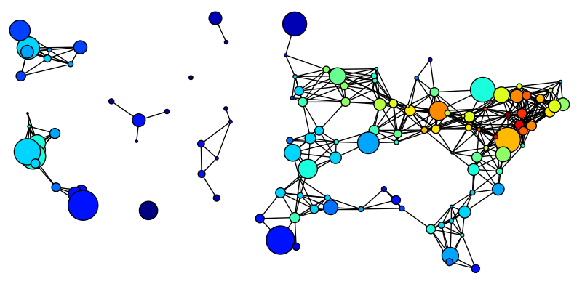
What is Networkx?
“Python package for the creation, manipulation and study of the structure, dynamics and functions of complex networks.”

Slide 31
Networkx
^{http://networkx.lanl.gov/}

Slide 32
Why use Networkx?
NetworkX defines no custom node objects or edge objects
node-centric view of network
nodes can be any hashable object, while edges are tuples with optional edge data (stored in dictionary)
any Python object is allowed as edge data and it is assigned and stored in a Python dictionary (default empty)
NetworkX is all based on Python
Instead, other projects use custom compiled code and Python: Boost Graph, igraph, Graphviz
Focus on computational network modelling not software tool development
Move fast to design new algorithms or models
Get immediate results

Slide 33
An Example
>>> import networkx as nx
>>> g = nx.Graph()
>>> g.add_edge(’a’,’b’,weight=0.1)
>>> g.add_edge(’b’,’c’,weight=1.5)
>>> g.add_edge(’a’,’c’,weight=1.0)
>>> g.add_edge(’c’,’d’,weight=2.2)
>>> print nx.shortest_path(g,’b’,’d’) [’b’, ’c’, ’d’] >>> print nx.shortest_path(g,’b’,’d’,weighted=True) [’b’, ’a’, ’c’, ’d’]

Slide 34
Drawing and Plotting w/ Networkx
It is possible to draw small graphs within NetworkX and to export network data and draw with other programs (i.e., GraphViz, matplotlib)

Slide 35
Networkx Tutorial and Download
Tutorial:
https://networkx.github.io/documentation/latest/tutorial/
Download:
https://networkx.github.io/download.html

